Slide 1
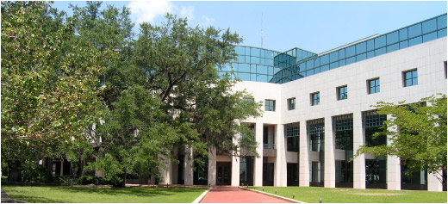
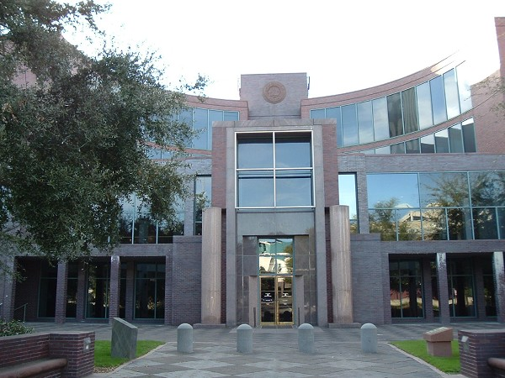
Chapter 9 - Local Government

Slide 2
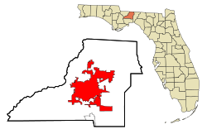
Local Governments 9.1 & 9.2
Local governments are established by and given powers from the state governments.
Their powers, responsibilities, and organization are defined by a charter from the state. A charter is a legal written document that establishes the organization of a local government (town, city, etc.)
Local governments provide local services such as: maintaining roads, providing running water, monitoring sewage systems, constructing sidewalks, street cleaning, and providing trash collection.

Slide 3
Local Governments 9.1 & 9.2
Local governments can also supervise privately or publically owned electric and transportation systems. (City of Tallahassee Utilities; StarMetro Bus)
Municipalities (also called towns, townships, villages, cities) are units of local government that are incorporated by the state and have self-government.
The main job for municipalities is to provide services for its citizens.

Slide 4
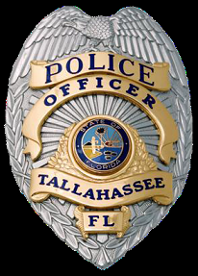
Local and County Governments
It is the job of local governments to make communities better places to live. They work to do this by passing ordinances.
Ordinances are laws (regulations) that govern a local community. They cannot conflict with state laws (statutes) or federal laws (acts).
What prevents local laws from overriding state/federal laws?
Local law enforcement groups are in charge of enforcing both ordinances and state laws.

Slide 5
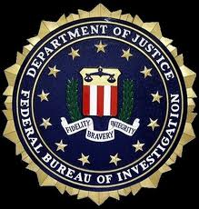
Ordinances, Statutes, and Acts
Statutes are laws passed by a state legislative body. They are NOT passed by cities or municipalities.
Acts are passed at the federal level and are federal laws. These laws will be enforced by federal agencies NOT city or state agencies.

Slide 6
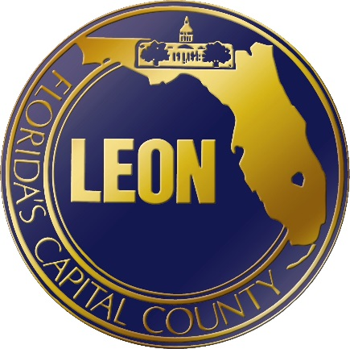
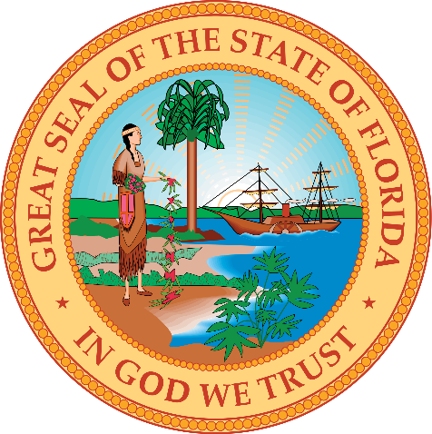
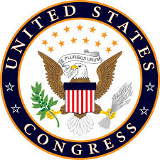
Lawmaking Process
Local | State | Federal
Ordinances are made by councils and commissions. Each county, city or municipality handles lawmaking differently. | Statutes are made by state legislatures. | Acts are made by our federal legislature, called Congress.

Slide 7
Organization and Purpose of
County Government
A county is a division of state government formed to carry out state laws. There are 67 counties in Florida and each county creates its own county government.
In Leon County, the county board/commission is elected by voters and forms the legislative body.
The county board or commission supervises elections; enforces state and county laws; collects taxes; and provides health and welfare services, libraries, roads, and schools.
NEXT
Notes:
Image is hyperlinked to Board of County Commissioners Meet Your Commission Website” http://cms.leoncountyfl.gov/Home/County-Commission/Meet-Your-Commissioners

Slide 8
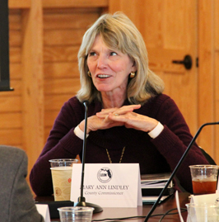
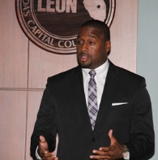
The Leon County Commission
The citizens of Leon County vote for the commissioner of their district (there are five districts) and for two At-Large seats.
At-Large means that these officials represent the whole county.
There are seven commissioners in total and they vote on issues and new ordinances brought up at Commission meetings.
NEXT

Slide 9
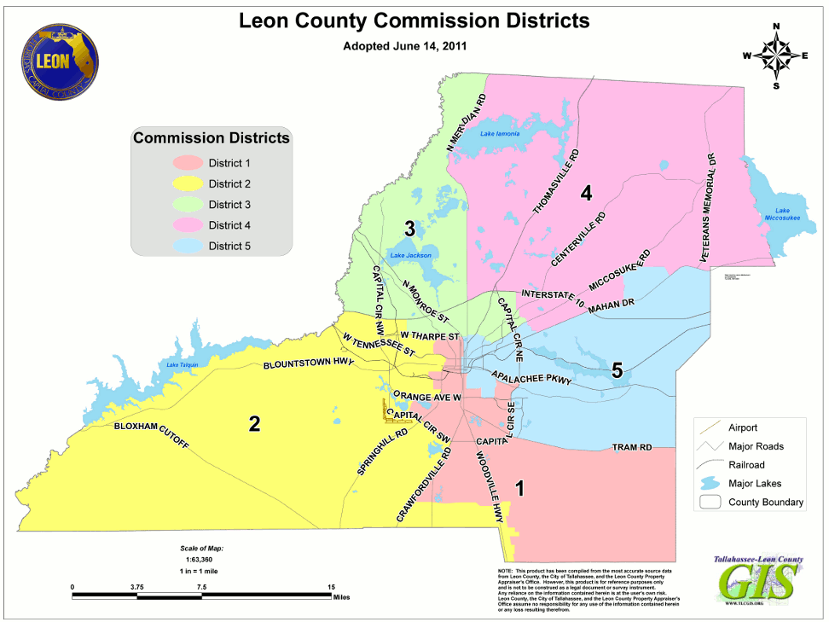
SECTION
1
Section 1: Units of Local Government
LEON COUNTY GOVERNMENT
NEXT

Slide 10
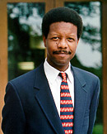
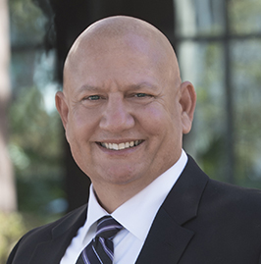
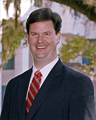
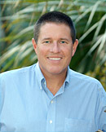
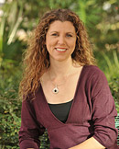
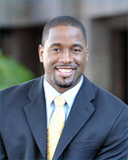
Leon County Commissioners
District 1
Bill Proctor
Distrit 2
Jimbo Jackon-son
District 3
John Dailey
District 4
Bryan Desloge
District 5
Kristin Dozier
At-Large
Nick
Maddox
At-Large
Mary Ann
Lindley
NEXT

Slide 11
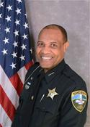
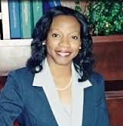
Organization and Purpose of
County Government
County officials can include a Sheriff and Sheriff Deputies, county clerk, treasurer, auditor, district attorney, tax collector, and supervisor of elections.
Sheriff Walt McNeil
Doris Maloy
Leon County Tax Collector

Slide 12
Types of Municipalities
There are many different types of municipalities (local governments) that exist across America.
Villages – are the smallest form of municipal government in Florida and can be created when populations grow and need to organize.
Towns – originated in the New England area and many towns there still practice direct democracy; towns generally have larger populations than villages and require more local services.
Cities – are the largest kind of municipalities. The state government grants home rule which allows cities to be created by charters that are approved by the voters.
NEXT

Slide 13
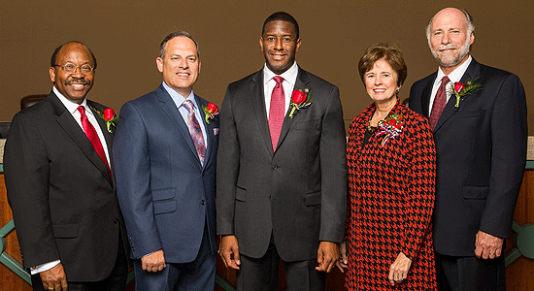
How Are Cities Formed?
Cities are created when populations grow and need to organize to better care for the people.
Cities are self-governing municipalities – which means they choose their leaders, pass ordinances, etc.
City governments collect taxes and provide local services
The city of Tallahassee is governed by a City Commission (legislative body) with an executive called, Mayor.
NEXT

Slide 14
The City of Tallahassee
FSU
Airport
Southwood
NEXT

Slide 15
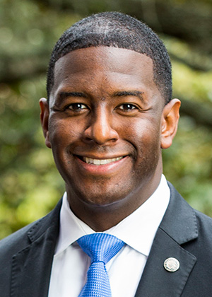
Tallahassee Government
Mayor: Andrew Gillum
Roles of the Mayor:
Presides at meetings
Head of the City/(also our ceremonial leader)
Enforces city ordinances
He has only one vote along with the Commission – he has no veto power
NEXT

Slide 16
Tallahassee Government City Commission
Curtis Richardson Gil Ziffer
Nancy Miller Scott Maddox
The City Commission meets regularly to discuss issues and work, vote on new policies, and work on planning for the city.

Slide 17
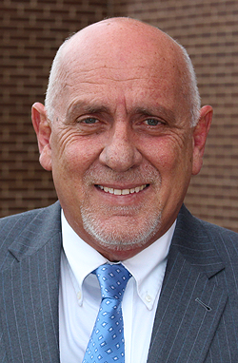
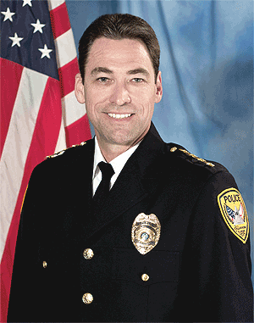
Tallahassee Government
The city also can have several other officials who are appointed to keep the city running.
City Manager
City Auditor
City Attorney
Treasurer-Clerk
Police Chief
Fire Chief
Chief of Police Michael DeLeo
City Manager Ricardo Fernandez
NEXT

